Slide 1
Chapter 11
Self, Identity, and Personality
Notes:
Add slide notes here

Slide 2
Defining Personality
What is personality? How would you define it and why?

Slide 3
Basic Concepts (1 of 2)
Personality
  Organized combination of attributes, motives, values, and behaviors unique to each individual
  Enduring pattern of behavior!
How to measure it?
  Dispositional traits
  Narrative identities
  Life stories

Slide 4
Basic Concepts (2 of 2)
Self-concept
  Perceptions of unique attributes and traits
Self-esteem
  Evaluation of worth as a person based on all the positive and negative self-perceptions that make up self-concept
Identity
  Overall sense of who they are, where they are heading, and where they fit into society

Slide 5
Theories of Personality (1 of 2)
Trait theory
  Personality is a set of dispositional trait dimensions along which people can differ
  Assumes that personality traits are consistent across situations
The Big Five
  Openness to experience, conscientiousness, extraversion, agreeableness, and neuroticism (OCEAN)

Slide 6
The Big Five Personality Dimensions
Dimension | Basic Definition | Key Characteristics
Openness to experience | Curiosity and interest in variety vs. preference for sameness | Openness to fantasy, esthetics, feelings, actions, ideas, values
Conscientiousness | Discipline and organization vs. lack of seriousness | Competence, order, dutifulness, striving for achievement, self-discipline, deliberation
Extraversion | Sociability and outgoingness vs. introversion | Warmth, gregariousness, assertiveness, activity, excitement seeking, positive emotions
Agreeableness | Compliance and cooperativeness vs. suspiciousness | Trust, straightforwardness, altruism, compliance, modesty, tender-mindedness
Neuroticism | Emotional instability vs. stability | Anxiety, hostility, depression, self-consciousness, impulsiveness, vulnerability
Notes:
Table 11.1 The Big Five Personality Dimensions

Slide 7
Theories of Personality (2 of 2)
Social learning theory
  Rejects the notion of universal stages of personality development
  Questions existence of enduring personality traits
  Emphasizes that people’s behavior is influenced by the situations and environment

Slide 8
The Emerging Self (1 of 4)
At 18 months
  Infants recognize themselves visually as distinct individuals
Babies also form categorical self by 18-24 months
  Classify selves into social categories based on age, sex, and other visible characteristics
Mirror Test: https://www.youtube.com/watch?v=Okmkn30D0NU

Slide 9
The Emerging Self (2 of 4)
Contributions to self-awareness in infancy
  Self-recognition depends on:
    Cognitive development
    Social interaction
Toddlers who recognize themselves in the mirror are more able to:
  Talk about themselves and to assert their wills
  Experience self-conscious emotions
  Coordinate their own perspectives with others

Slide 10
The Emerging Self (3 of 4)
Age 3–4: understand and describe themselves concretely, may replicate and internalize racial biases.
Middle childhood: shift from concrete descriptions to trait-like psychological constructs.
Notes:
LO 11-1: Summarize developmental trends in self-concept from infancy through adulthood.
C. Childhood
a. 3- and 4-year-olds understand and describe themselves concretely, using observable descriptors
b. Children begin to include emotions and attitudes in their self-descriptions, suggesting an emerging awareness of internal characteristics
c. Middle childhood: self-concept shifts from concrete descriptions of behavior to trait-like psychological constructs
d. Traits
i. Older children: include positive and negative traits and understand their traits can vary with context
ii. Age 9: children describe themselves across a range of domains (physical, academic, athletic and social self-concept and beliefs about behavioral conduct)
e. Skin Color
i. Children notice physical differences associated with race (e.g., skin color and hair color and texture)
ii. 3- and 4-year-old white children express pro-white bias in dolls, peers, and toys; children of color may show preferences for lighter skin or internalize racial biases
iii. Age 9: bias declines dramatically
iv. Young children internalize race-related messages into their early understanding of self
v. Parents and teachers can counter discriminatory messages with an anti-bias framework that includes learning about race through reading and discussion
f. Culture
i. Children’s self-conceptions are influenced by interactions with parents and cultural context
ii. Example: U.S. children’s focus on their attributes and positive inner traits vs. Chinese children’s focus on social interactions/daily routines and neutral or modest descriptions of themselves

Slide 11
The Emerging Self (4 of 4)
Adolescence: Use abstract, complex labels to describe themselves in a variety of domains.
Recognize their feelings, attitudes, and behaviors may change, so they begin using qualifiers in self-descriptions.
Identify an ideal self—who they aspire to be.
A mismatch between the ideal vs. real self is associated with depression, low self-esteem, and poor grades.
Notes:
LO 11-1: Summarize developmental trends in self-concept from infancy through adulthood.
D. Adolescence
a. Adolescents use abstract, complex labels to describe themselves in a variety of domains (e.g., academics, social skills, physical abilities, appearance, and emotional regulation skills)
b. Young people recognize their feelings, attitudes, and behaviors may change, so they begin to use qualifiers in self-descriptions
c. As adolescents become able to consider the future, they identify an ideal self—who they aspire to be
c. A mismatch between the ideal versus real self is associated with depression, low self-esteem, and poor school grades
d. Supportive relationships with parents and teachers promote a positive sense of self-concept

Slide 12
Identity (1 of 2)
Identity: sense of self that is coherent and consistent over time.
Psychosocial moratorium: in-between period where adolescents can experience the freedom to explore and develop without the responsibilities of adulthood.
  Usually a time of uncertainty!
Notes:
LO 11-3: Examine processes of identity development, including its influences and outcomes.
III. Identity
A. Identity: a sense of self that is coherent and consistent over time
B. Identity achievement: the successful establishment of a coherent sense of self
C. Psychosocial Moratorium
a. Psychosocial moratorium: Erikson’s idea of an in-between period where adolescents can experience the freedom to explore and develop without the responsibilities of adulthood
b. Adolescents might examine careers, personalities, desires, religion, and other aspects of identity, becoming increasingly confident about their choices over time
c. Sense of identity—an understanding of who one is and where they are going
d. Unsuccessful resolution of identity search: confusion and isolation
e. Adolescents navigate shifts in certainty moment-to-moment
f. Uncertainty is uncomfortable, motivating young people to seek resolution and reduce the discomfort

Slide 13
Forging an Identity (1 of 2)
Erikson
  Adolescence is a critical period in the lifelong process of forming an identity as a person
  Identity vs. role confusion
  Adolescent must integrate varied perceptions of the self-concept into a coherent sense of self
    What kind of career do I want?
    Where do I fit in?

Slide 14
Forging an Identity (2 of 2)
Marcia expanded on Erikson’s theory
  Adolescents are classified into one of four identity statuses depending on whether an individual has:
    Experienced a crisis
    Achieved a commitment
Identity formation takes time
  Only half of the 24-year-olds achieved a firm identity!

Slide 15
Identity (2 of 2)
Identity moratorium: active exploration of ideas and a sense of openness to possibilities, coupled with some uncertainty.
Identity achievement: successful establishment of a coherent sense of self.
Identity diffusion: individual has not explored or committed to a sense of self, characterized by pervasive uncertainty with little motive for resolution.
Identity foreclosed: individual has prematurely chosen an identity without having engaged in exploration and tends to be inflexible and view the world in black and white.
Notes:
LO 11-3: Examine processes of identity development, including its influences and outcomes.
D. Identity Status
a. Identity status: the degree to which individuals have explored possible selves and whether they have committed to specific beliefs and goals
b. Identity diffusion: the least mature identity status where an individual has not explored or committed to a sense of self and which is characterized by pervasive uncertainty with little motive for resolution
c. Identity foreclosed: the identity status that indicates an individual has prematurely chosen an identity without having engaged in exploration and tends to be inflexible and view the world in black and white, right and wrong, terms

Slide 16
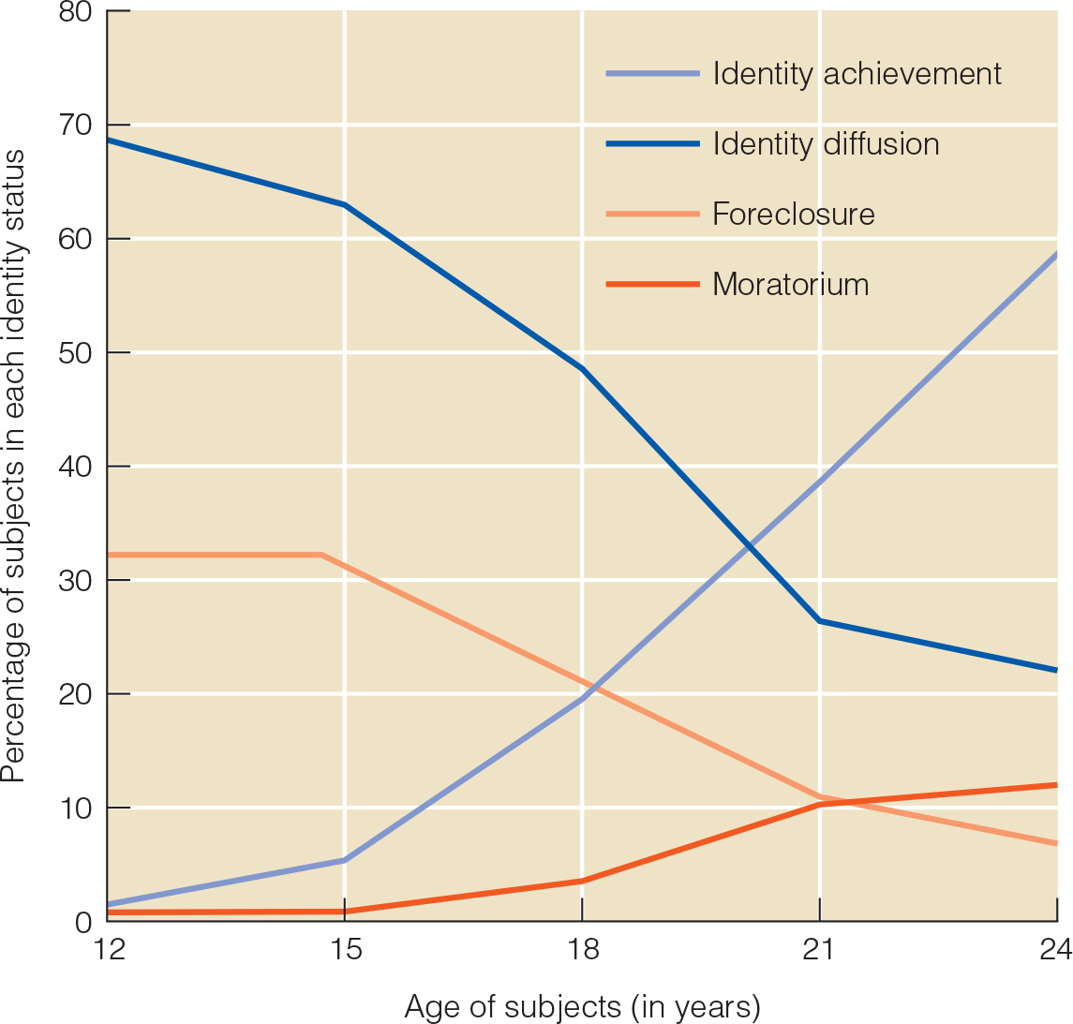
Notes:
Figure 11.2 Percentage of subjects in each of James Marcia’s four identity statuses as a function of age.

Slide 17
Influences on Identity Formation
Influences on identity formation
  Cognitive development
  Personality
  Quality of the relationship with parents
  Opportunities for exploration
  Cultural context

Slide 18
Self Concept and Aging
Subjective age: how old one feels, including physical abilities, cognition, and health.
Until emerging adulthood, people feel older.
By 30, adults view themselves as younger.
May attempt to avoid negative consequences of identification with their age group.
Younger subjective ages associated with better physical and cognitive functioning.
Notes:
LO 11-1: Summarize developmental trends in self-concept from infancy through adulthood.
E. Adulthood
a. Our beliefs about what is possible, who we might become, shift in adulthood (from grand aspirations to balanced images of possible selves)
b. Middle-aged adults are more likely to acknowledge and accept their good and bad qualities and feel positively about themselves
c. Older adults tend to compartmentalize their self-concept by categorizing the positive and negative aspects of self as separate roles
d. Subjective Age
i. Subjective age: how old one feels
ii. Until emerging adulthood, people feel older than their chronological age
iii. By 30, adults view themselves as younger than their chronological age
iv. Why Do Adults Consistently Identify with Their Younger Selves?
1. Subjective age includes physical abilities, cognition, and health
2. Given negative stereotypes associated with aging, adults may employ strategies to avoid negative consequences of identification with their age group (e.g., denying/hiding age by excluding themselves from the “old age” category)
3. Adults with negative self views are more likely to feel older than their years over time
4. Individuals experiencing challenging contexts and situations report older subjective ages
v. Correlates of Subjective Age
1. Adults who view themselves as younger score high on measures of well-being
2. Younger subjective ages are associated with better physical and cognitive functioning
vi. Subjective Age as a Protective Factor
1. Adopting a younger subjective age may be a coping mechanism to psychologically distance themselves from old age and perceived vulnerability to a deadly illness (COVID-19)
2. Subjective age is malleable in response to contextual conditions (e.g., expecting to take a memory test and body pain are associated with feeling older)
3. Perceiving oneself as younger/older can alter perceived control over life and activities

Slide 19
Self-Esteem
Early Childhood
  Most young children have a positive sense of self.
  Social comparisons: assessment of children’s ability and potential compared to that of other children.
Elementary school: self-esteem increases but becomes more complex (academics, social and athletic ability).
When parents overvalue children’s attributes, children may develop a sense of narcissism.
Notes:
LO 11-2: Analyze patterns of change and correlates of self-esteem over the lifespan.
II. Self-Esteem
A. Self-esteem: self-evaluation, which involves feelings of self-worth, self-acceptance, and self-respect, qualities that rely on the cognitive development and a sense of self that emerge in childhood and develop throughout the life span
B. Early Childhood
a. Most young children have a positive sense of self, evidenced by their overconfidence in their performance on various tasks, regardless of outcome
b. Social comparisons: an assessment of children’s ability and potential compared to that of other children
c. Age 4-7: self-evaluations become linked with performance
d. Self-esteem is promoted by supporting attempts at difficult tasks, emphasizing effort, providing feedback, taking pride in success, and unconditional support
C. Middle Childhood
a. Children get feedback on their abilities and evaluate their abilities more objectively
b. Those whose self-evaluations depend heavily on approval are at risk for poor self-esteem
c. Elementary school: self-esteem increases but becomes more complex (academics, social and athletic ability)
d. Self-esteem is nurtured by warm caregivers who express positive emotions, acceptance, and the sense the child matters
e. When parents overvalue children’s attributes, children may develop a sense of narcissism

Slide 20
Changes in Self-Esteem (1 of 5)
Self-esteem becomes more differentiated or multidimensional with age
  By mid-elementary school, children differentiate among five aspects
    Scholastic competence
    Social acceptance
    Behavioral conduct
    Athletic competence
    Physical appearance

Slide 21
Influences on Self-Esteem
Reasons some children develop higher self-esteem
  Self-esteem is heritable
  Environment also plays a role
    Warm, democratic parents
    Helping children succeed at important tasks
Self-esteem is stable over the elementary school years

Slide 22
Changes in Self-Esteem (2 of 5)
Adolescence
  Self-esteem declines around 11, reaches a low point at ~13.
  Quality parent relationships associated with higher self-worth.
  Peer acceptance can buffer negative effects of a distant relationship with parents.
Notes:
LO 11-2: Analyze patterns of change and correlates of self-esteem over the lifespan.
D. Adolescence
a. Adolescents describe/evaluate themselves overall and in specific areas and develop positive self-esteem when they evaluate themselves favorably in areas they view as important
c. Self-esteem declines around 11 and reaches a low point at ~13
d. This trend is true for all children but girls show worse self-esteem
e. Black adolescents have higher self-esteem, which can buffer effects of discrimination
f. Connections in community help explain ethnic differences
g. High self-esteem: more confidence, being sure of oneself and kind to oneself
h. Low self-esteem: risky behavior and adjustment difficulties
i. High quality parent–adolescent relationships are associated with higher estimates of self-worth and better adjustment
j. Peer acceptance can buffer negative effects of a distant relationship with parents
E. Adulthood
a. Self-esteem rises in adulthood—peaking at ~60, then declining afterwards
b. Young adults begin taking on new social roles, and competence in these roles improves self-esteem
c. Middle-aged adults become more independent, and cognitive affective complexity increases, lifting self-esteem even further
d. Self-esteem declines in older adults as they take on new roles (e.g., retirement or widowhood)
e. Life experiences and increases in cognitive affective complexity can offset some of the declines in self-esteem, as older adults may be better able to accept their weaknesses and focus on their strengths

Slide 23
Changes in Self-Esteem (3 of 5)
Most emerge from adolescence with high self-esteem, if:
  There are opportunities to feel competent
  Experience approval and support from peers, parents
Adolescents with high self-esteem:
  Have better physical and mental health
  Better career and financial prospects
  Lower involvement in criminal behavior

Slide 24
Changes in Self-Esteem (4 of 5)
Adulthood
  Young adults take on new social roles, and competence improves self-esteem.
  Middle-aged adults become more independent, lifting self-esteem.
Notes:
LO 11-2: Analyze patterns of change and correlates of self-esteem over the lifespan.
D. Adolescence
a. Adolescents describe/evaluate themselves overall and in specific areas and develop positive self-esteem when they evaluate themselves favorably in areas they view as important
c. Self-esteem declines around 11 and reaches a low point at ~13
d. This trend is true for all children but girls show worse self-esteem
e. Black adolescents have higher self-esteem, which can buffer effects of discrimination
f. Connections in community help explain ethnic differences
g. High self-esteem: more confidence, being sure of oneself and kind to oneself
h. Low self-esteem: risky behavior and adjustment difficulties
i. High quality parent–adolescent relationships are associated with higher estimates of self-worth and better adjustment
j. Peer acceptance can buffer negative effects of a distant relationship with parents
E. Adulthood
a. Self-esteem rises in adulthood—peaking at ~60, then declining afterwards
b. Young adults begin taking on new social roles, and competence in these roles improves self-esteem
c. Middle-aged adults become more independent, and cognitive affective complexity increases, lifting self-esteem even further
d. Self-esteem declines in older adults as they take on new roles (e.g., retirement or widowhood)
e. Life experiences and increases in cognitive affective complexity can offset some of the declines in self-esteem, as older adults may be better able to accept their weaknesses and focus on their strengths

Slide 25
Changes in Self-Esteem (5 of 5)
Self-esteem rises gradually through the adult years until the mid-60s, and then drops in late old age
Sense of clarity about who they are rises through middle age and declines in old age
Gender differences in self-esteem disappear in old age

Slide 26
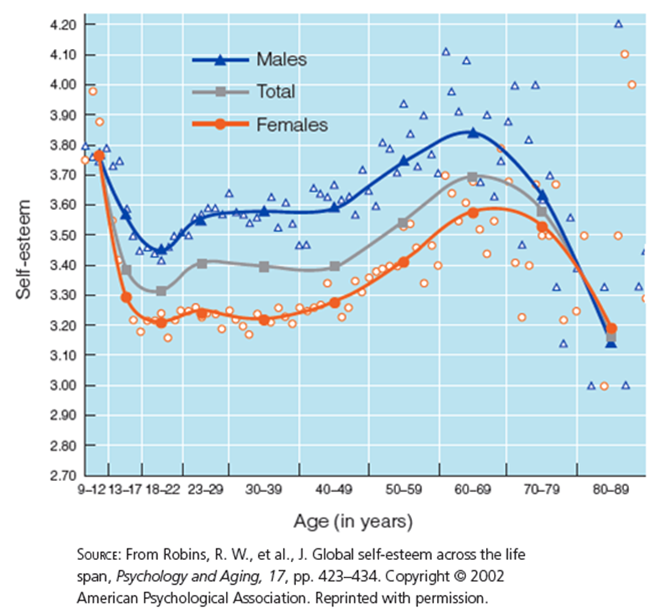
Self-Esteem over the Life-Span
Notes:
Figure 11.3 Self-esteem dips in early adolescence and rises during the adult years

Slide 27
Temperament (1 of 2)
Temperament
  Early, genetically based but environmentally influenced tendencies to respond in predictable ways to events that serve as the building blocks of later personality
    Easy temperament
    Difficult temperament
    Slow-to-warm-up temperament

Slide 28
Temperament (2 of 2)
Rothbart and colleagues identified three dimensions of temperament
  Surgency/extraversion
    Tendency to actively, confidently, and energetically approach new experiences in emotionally positive way
  Negative affectivity
    Tendency to be sad, easily frustrated, and irritable
  Effortful control
    Ability to focus and shift attention when desired, inhibit responses

Slide 29
Surgency/Extraversion, Negative Affect,
& Effortful Control
Surgency/extraversion: tendency to actively, confidently, and energetically approach new experiences in an emotionally positive way
Negative affectivity: tendency to be sad, fearful, easily frustrated, irritable, and difficult to soothe
Effortful control: ability to focus and shift attention, inhibit responses, and appreciate low-intensity activities

Slide 30
Temperament and Personality
Dimensions of early temperament are related to Big Five personality traits later in life
  Self-controlled children do well in school, are socially and morally mature
    Healthier, more financially stable in their 30s
    Able to focus on their long-term goals, act responsibly to pursue them, and resist temptations that might distract them

Slide 31
Personality Development (Trait Approach)
Birth–infancy: personality represented by temperament.
Early childhood: personality reflected by emotional development.
Early adulthood: the maturity principle—increased conscientiousness, agreeableness, and emotional stability.
Throughout adulthood: agreeableness and conscientiousness increase; neuroticism, extroversion, and openness decline into middle adulthood.
  Most people experience a mellowing of personality characteristics with age.
Notes:
LO 11-5 Compare and contrast trait and psychosocial stage approaches to personality.
b. Personality Traits in Childhood and Adolescence
i. Birth-infancy: personality is represented by temperament
ii. Early childhood: personality is reflected by emotional development
iii. Maturity of most Big 5 traits decline from childhood to adolescence, with the exception of neuroticism, which increases and then levels off
c. Personality Stability and Change in Adulthood
i. Early adulthood: the maturity principle—increases in conscientiousness, agreeableness, and emotional stability
ii. Investing in new roles can lead to changes in personality traits
iii. Throughout adulthood, agreeableness and conscientiousness increase; neuroticism, extroversion, and openness decline into middle adulthood
iv. Most people experience a mellowing of personality characteristics with age (e.g., extroversion, conscientiousness, agreeableness)

Slide 32
Seasons of Life Approach to Personality
Seasons of life: Levinson’s set of phases that adults progress through as a result of the interplay of intrapersonal and social forces.
Life structure: the overall organization of a person’s life.
  Transition to early adulthood (17–22)
  Young adults (22–28)
  Age 30 transition (28–33)
  Settling down vs. unsettled middle adulthood (34–40s)
  Transition to middle adulthood (40–45)
Notes:
LO 11-5 Compare and contrast trait and psychosocial stage approaches to personality.
b. Levinson’s Seasons of Life
i. Seasons of life: Levinson’s set of phases that adults progress through as a result of the interplay of intrapersonal and social forces
ii. Life structure: the overall organization of a person’s life: relationships with significant others as well as institutions such as marriage, family, and vocation
iii. Transition to early adulthood (17-22): construct life structure by creating a dream, which then guides life choices
iv. Young adults (22-28): work to realize dreams and construct the resulting life structure
v. Age 30 transition (28-33): reconsideration of the life structure in which priorities may shift from career to family, or vice versa (potential midlife crisis)
vi. Settling down (men) vs. unsettled middle adulthood (women) (34-40s)
vii. Transition to middle adulthood (40 to 45): reexamine the dream established in early adulthood, evaluate progress, and reconcile reality with the dream
viii. Levinson based his ideas on a very small sample of adults, and the seasons influenced by context

Slide 33
Personality Development (Freud)
Freud’s view: personality is fully formed by age five
Not supported!
  Personalities change in response to environmental influences
  Some aspects of personality do not seem to stabilize until adolescence

Slide 34
Personality Development (Erikson)
Stage | Age Range | Central Issue | Virtue/Strength
Trust vs. mistrust | Birth – 1 year | Can I trust others? | Hope
Autonomy vs. shame and doubt | 1-3 years | Can I act on my own? | Will
Initiative vs. guilt | 3-6 years | Can I carry out my plans successfully? | Purpose
Industry vs. inferiority | 6-12 years | Am I competent compared to others? | Competence
Identity vs. role confusion | 12-20 years | Who am I and where am I going? | Fidelity
Intimacy vs. isolation | 20-40 years | Am I ready for a committed relationship? | Love
Generativity vs. stagnation | 40-65 years | Have I given something to future generations? | Care
Integrity vs. despair | 65 years + | Has my life been meaningful? | Wisdom
Notes:
Table 11.4 The Eight Stages of Erikson’s Psychosocial Theory

Slide 35
Continuing Psychosocial Growth
Research supports Erikson’s view that women and men are capable of psychosocial growth during middle adulthood
Elderly adults confront the psychosocial issue of integrity versus despair
  Try to find a sense of meaning in their lives that will help them face the inevitability of death

Slide 36
Midlife Crisis?
Erikson: discussed few signs of midlife crisis
Levinson believed that there is:
  A transition period from age 40 to 45
  Midlife crisis
    A person questions his life structure and raises unsettling issues
Most researchers agree there is a midlife questioning period

Slide 37
Late Adulthood
Integrity versus despair
  Complete psychosocial growth
Life review
  Reminisce and reflect on unresolved conflicts of the past to come to terms with themselves, find new meaning and coherence in their lives, and prepare for death

Slide 38
Successful Aging and Psychological Well-Being
Successful aging
  An aging experience that is better overall that typical aging
  What does this look like?
Rowe & Kohn:
  Freedom from disease and disability
  Good cognitive and physical functioning
  Active engagement with life

Slide 39
Theories of Successful Aging (1 of 2)
Activity theory
  Aging adults will find their lives satisfying if they can:
    Maintain their previous lifestyles and activity levels
    Continue old activities
    Find substitutes
Disengagement theory
  Successful aging involves a withdrawal of aging individual from society that is satisfying to both

Slide 40
Theories of Successful Aging (2 of 2)
More support for activity theory than for disengagement theory
  Some seniors to become less active
Interactionist model of development
  Emphasizes the goodness of fit between person and environment and their influence on one another

